Slide 2
Company Profile
- Founded in 1984
- Total production capacity 10.000 ton/year
- Total area 15.000 m² of which 4.000 m² are covered
- 150 qualified employees
Main activities;
- The production of gray and ductile iron castings.
- Machining
- Heat treatment, coating and electro galvanizing
- Casting weights; from 0,5 kg. to 1000 kg.
Alfa has been ISO 9001: 2008 certified since 2003 and we received
PED-97/23/EC certificate in 2015.

Slide 3
Our Staff
Education | Numbers
Universty Graduate (Engineer) | 8
Universty Graduate (Other) | 5
Vocational Collage | 3
Technical High School | 2
High School | 2
Other | 130
TOTAL | 150

Slide 4
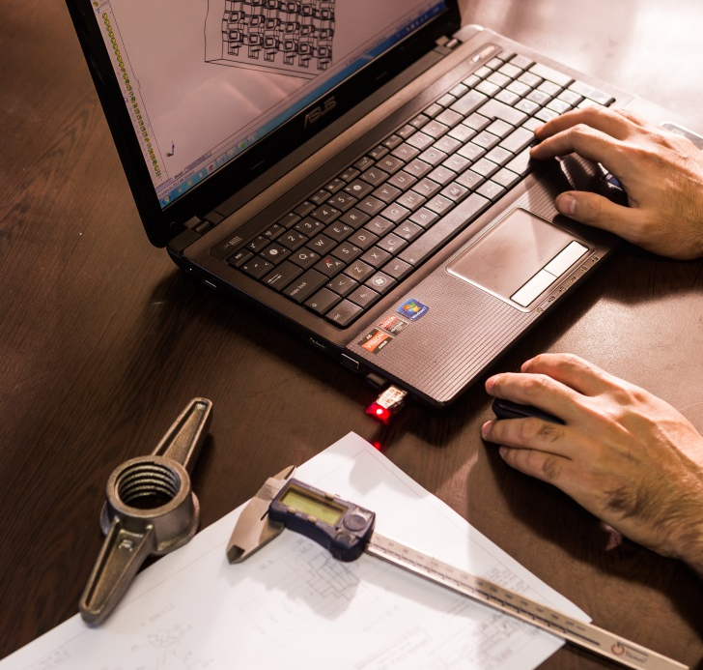
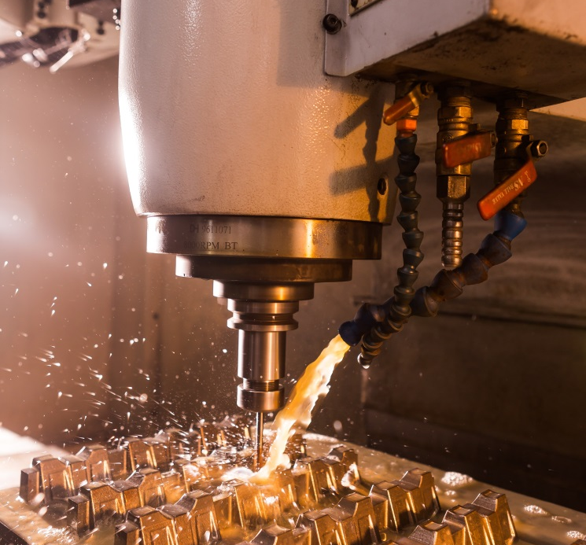
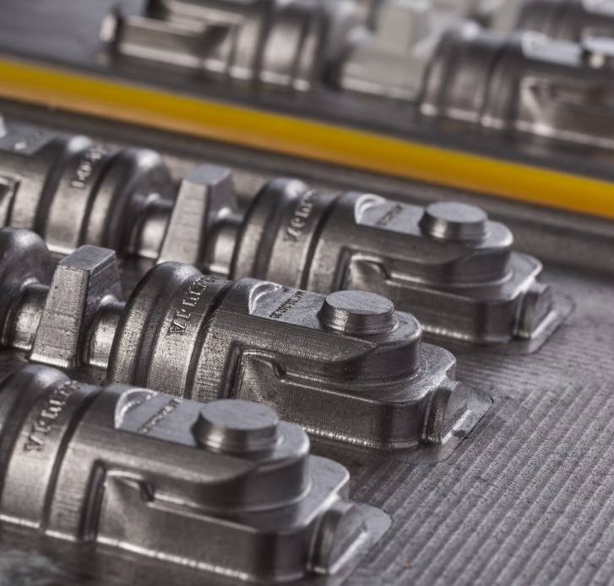

Production Processes
Pattern Design and Production
The CAD/CAM software SOLIDWORKS , used for designing the patterns, enables us to make 3D Models of the parts to be casted and also to determine the part weights.
Our specialists develop an optimum pattern concept allowing for a casting and feeding system matced to the casting, the appropirate mould level, the material-spesific degree of shrinkage and any machining allowonces.
We operate two CNC vertical machining centres,one CNC lathe and one conventional lathe at the pattern shop to make pattern.We make pattern from cast iron, aluminium and synthetic resin depending on the life of pattern.

Slide 5
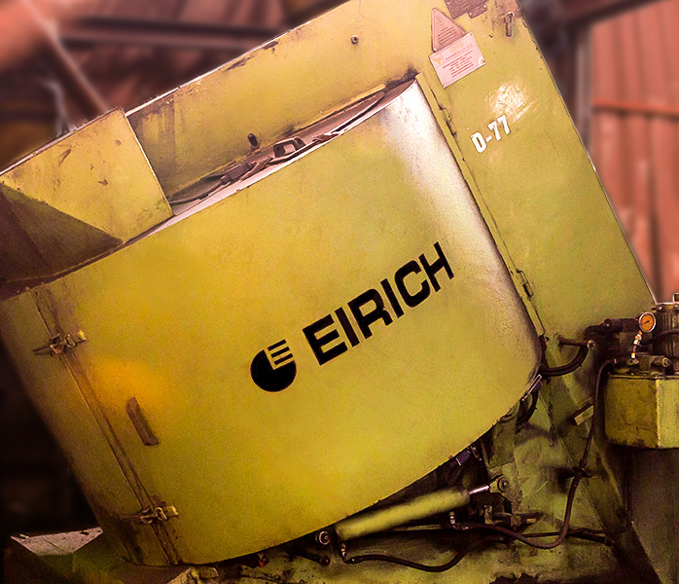
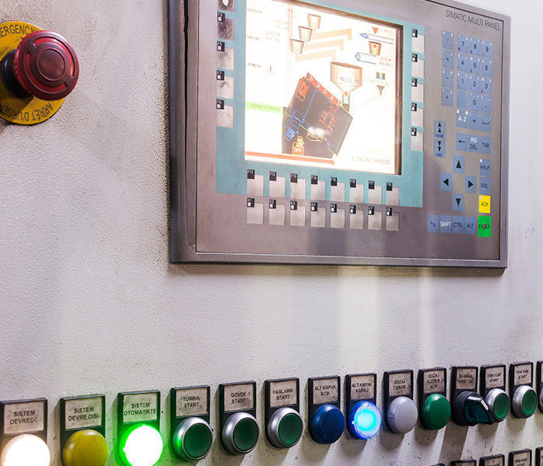
Production Processes
Sand Preparation
Our fully automatic sand preparation plants are PLC controlled and enable us to achieve best possible results in terms of surface quality for our castings
For sustainable sand quality, mix preparation is controlled at every batch for compactability, green strength and moisture.
Furthermore, samples are also manually taken and cross checked in our quality lab to ensure that the required specifications are met.
Besides green sand system, we also utilise furan system for our semi-automatic moulding line, as well as for hand moulding.
1 x SAND PREPARING LINE
1 x EIRICH MIXER

Slide 6
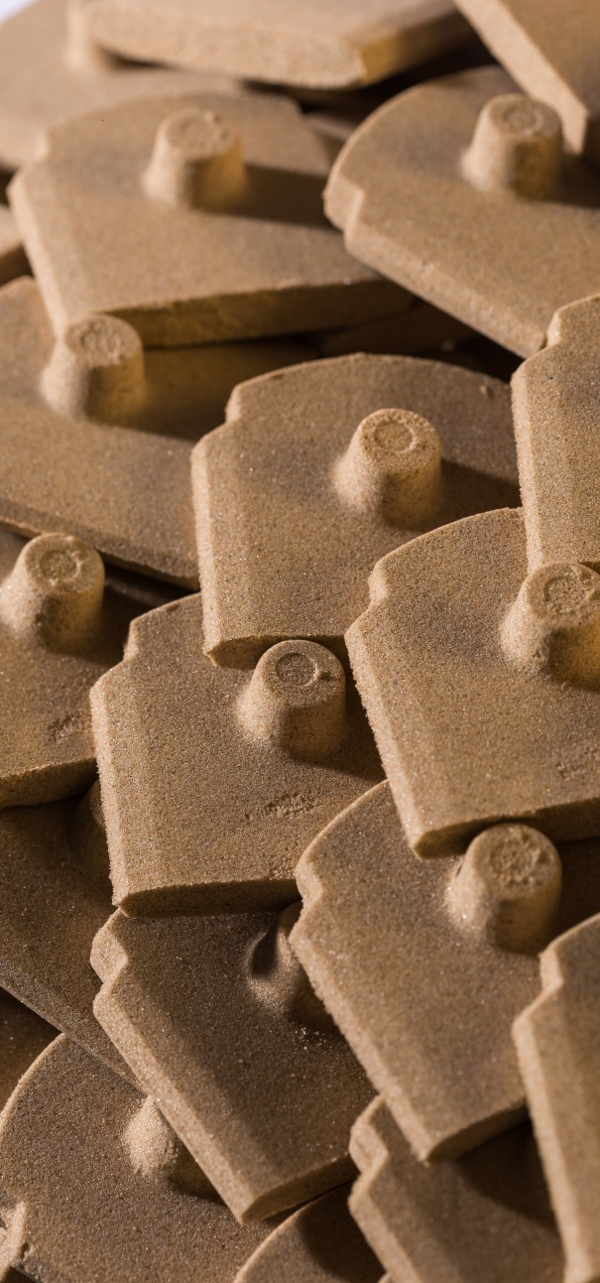
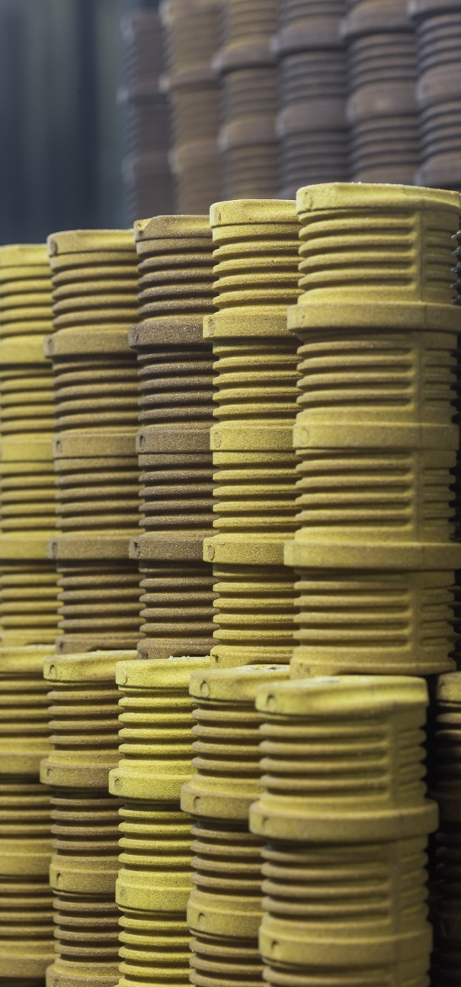
Production Processes
Core Making
According to the requirements of the castings demanded by our customers, we utilise different kinds of base materials for the production of cores
Utilised core machines are;
1X C02 5 kg
1X CO2 12 KG
4X SHELL CORE 5 KG
1XCOLD BOX LAMPE H5
1XCOLD BOX LAMPE H12
Technical Facilities
Machines: Laempe, Şenel, Faz
Core Box Porting Line: Horizontally
Core Production: Cold Box, Shell Core and CO2
Shooting Volume : 5-10 liters

Slide 7
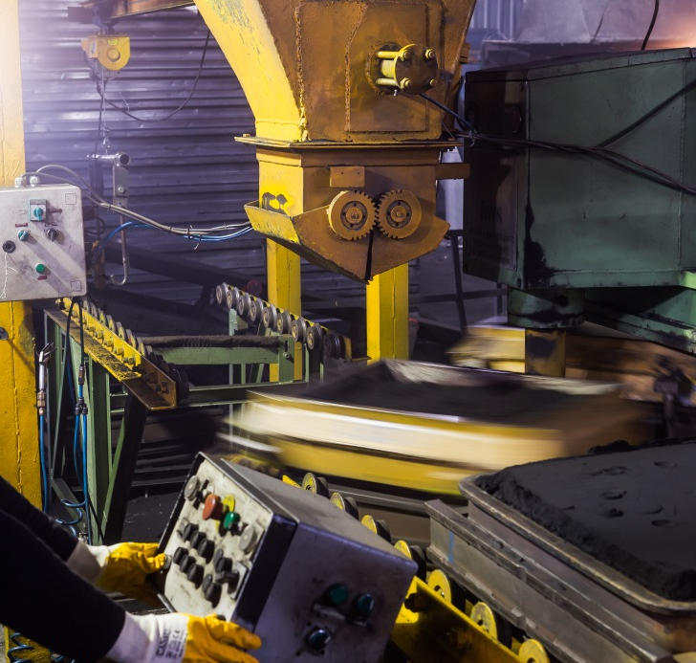
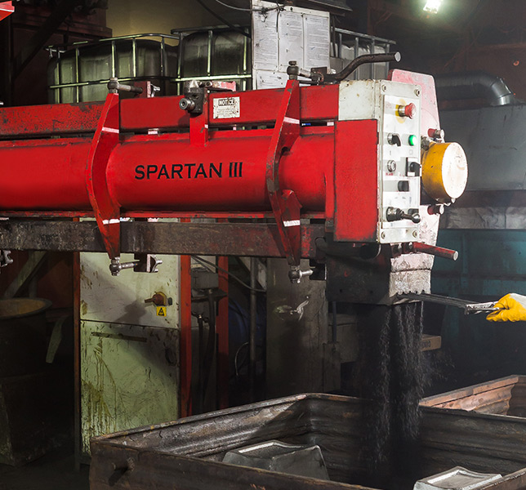
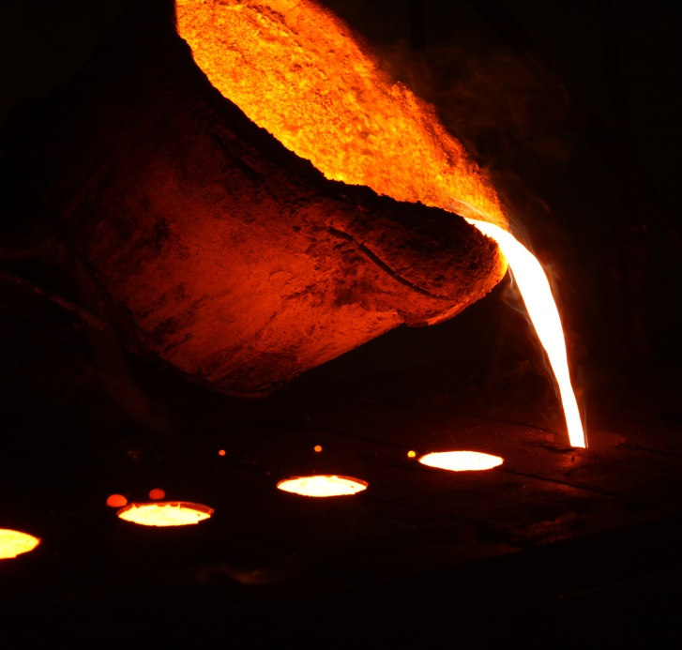
Production Processes
Moulding
• 3 Lines Disamatic 2110
Moulding Box Size: 500x400x200
Moulding Speed: 200 moulds/hour
• 1 Line HWS-HSP1 Moulding Machine
Box Size: 650x500x200/200
Moulding Speed: 25 moulds/hour
• 1 Line Omega Resin Sand Moulding
Capacity: 10 tons/hour

Slide 8
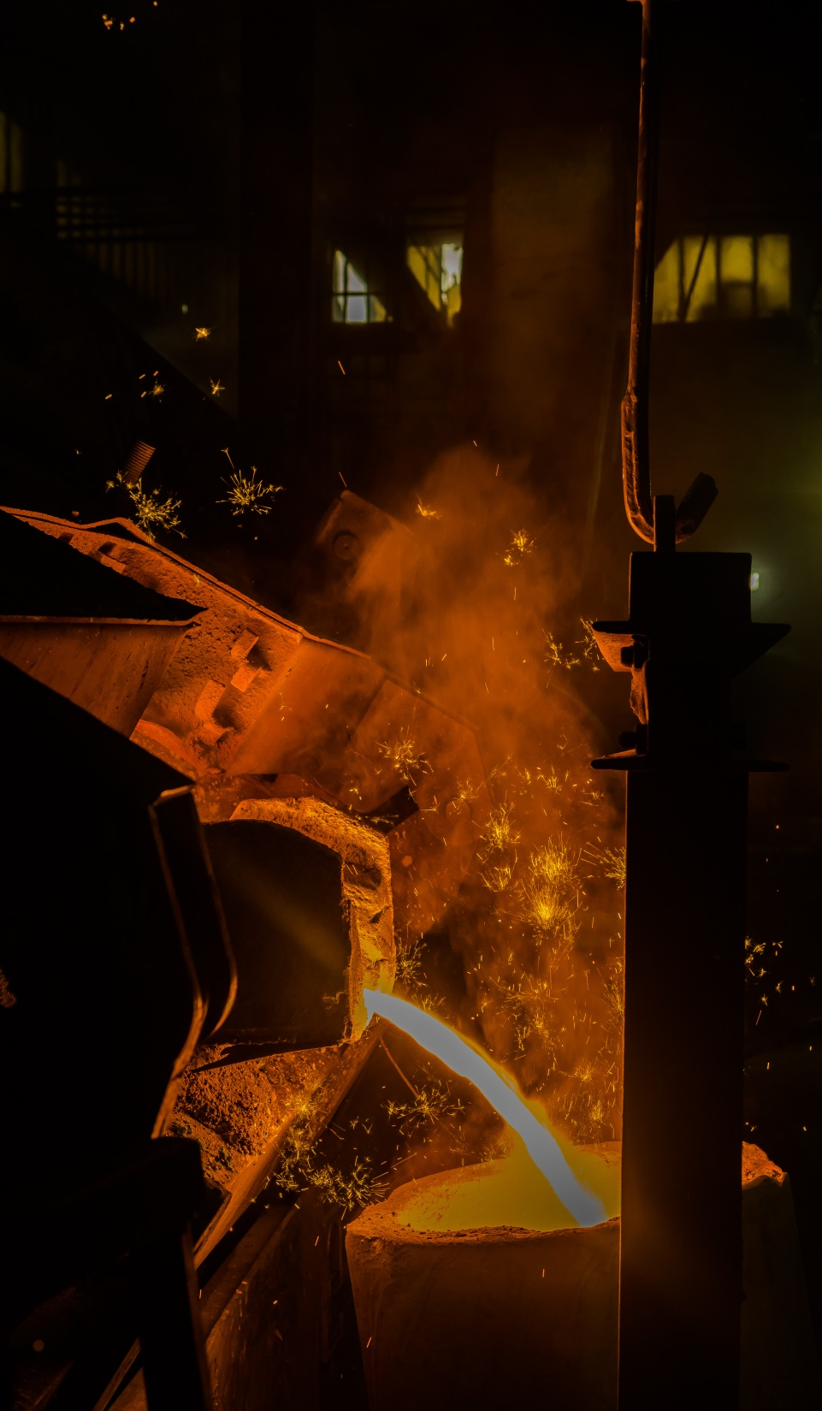
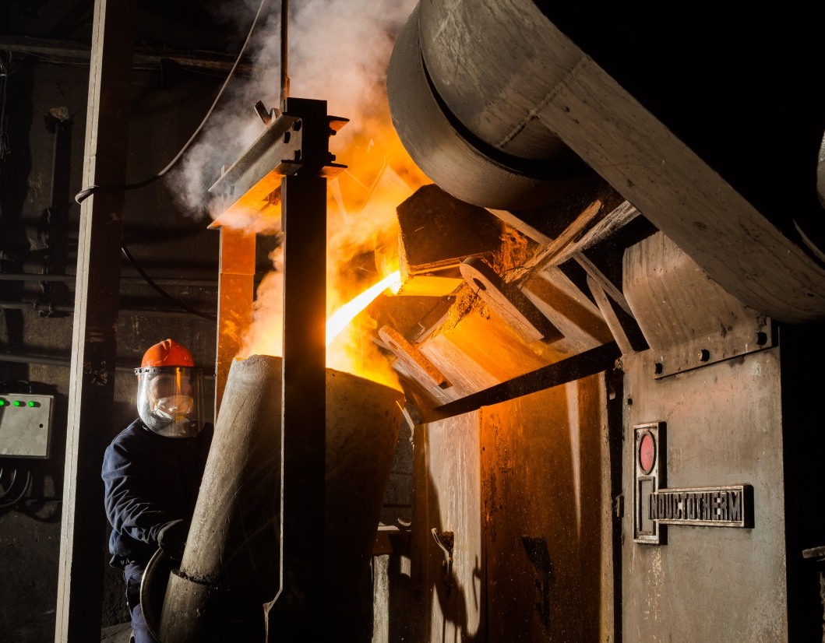
Production Processes
Melting & Pouring
• 1 Mains Frequency Induction Furnace-Inductotherm,
Dual- truck, 2250 KW Capacity: 4 tons/hour
• 1 Mains Frequency Induction Furnace-Inductotherm,
600 KW Capacity: 1 ton/hour
• 1 Mains Frequency Induction Furnace-Inductotherm,
400 KW Capacity: 0,75 ton/hour

Slide 9
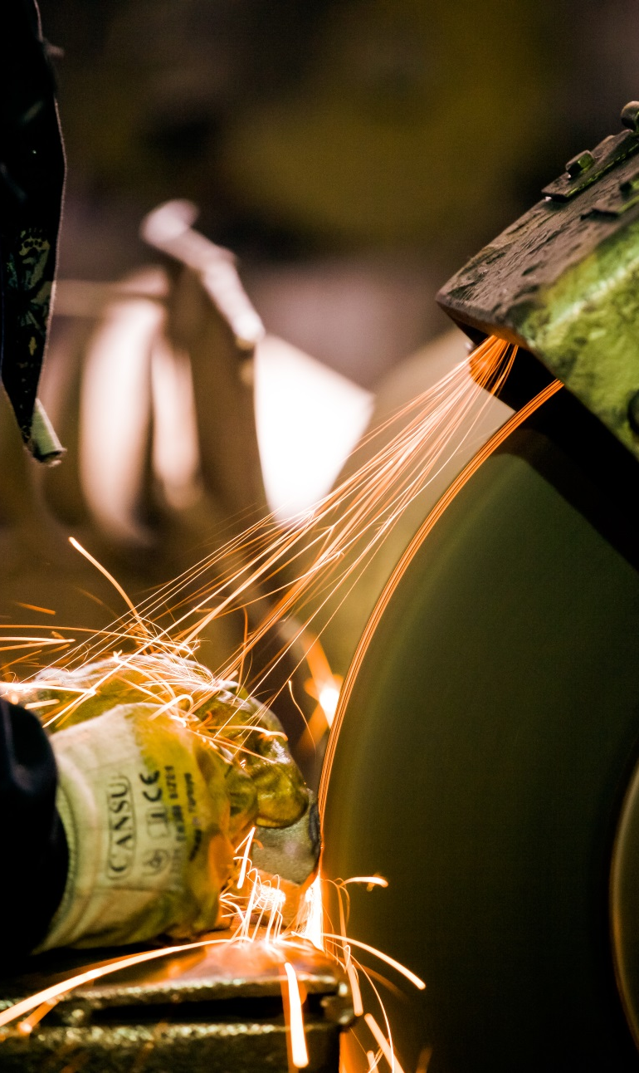
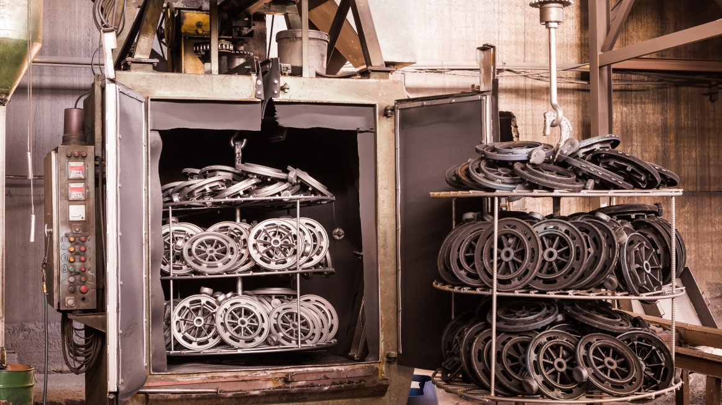
Production Processes
Finishing Shop
• 2 Rubber Belt Tumble Blast Machine
Capacity 1,2 ton/hour
Mark: Endümak
• 1 Hanging Type Shot Blast Machine
Capacity: 4 tons/hour
Mark: Endümak
• 2 Heat Treatment Furnace
(for stress relieving , normalizing and ferritizing)
Electro Galvanizing
• 8 Floor Grinder
ᴓ600mm, 60m/s
Rema

Slide 10
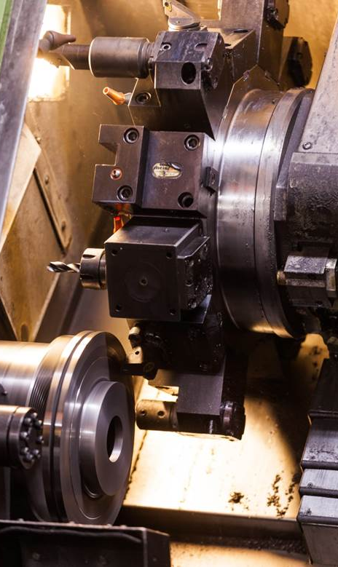
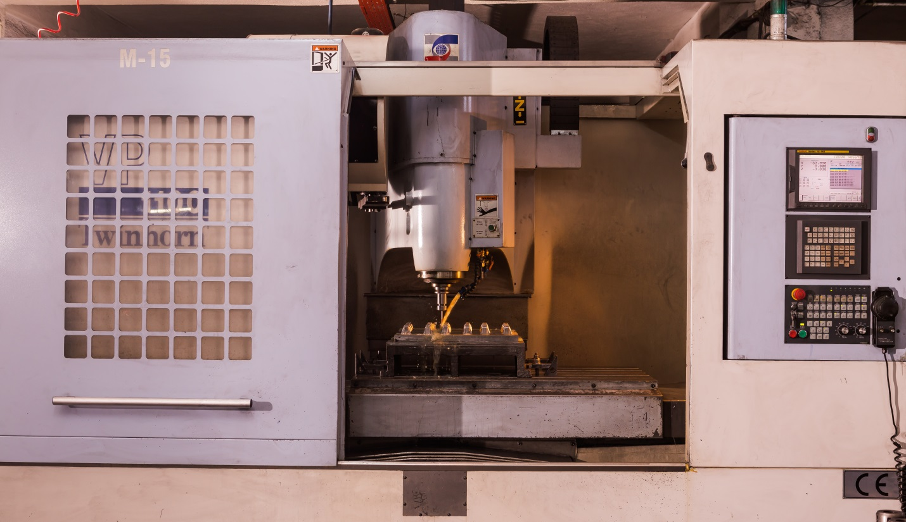
Production Processes
Machining
• 2 x CNC Vertical Machining Centre
• 2 x CNC Lathe

Slide 11
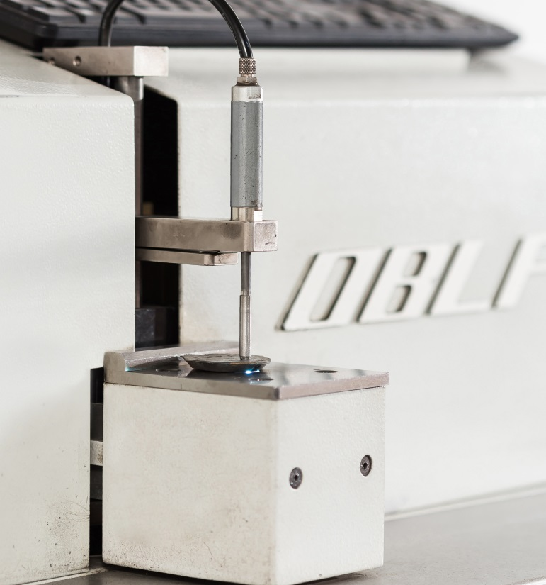
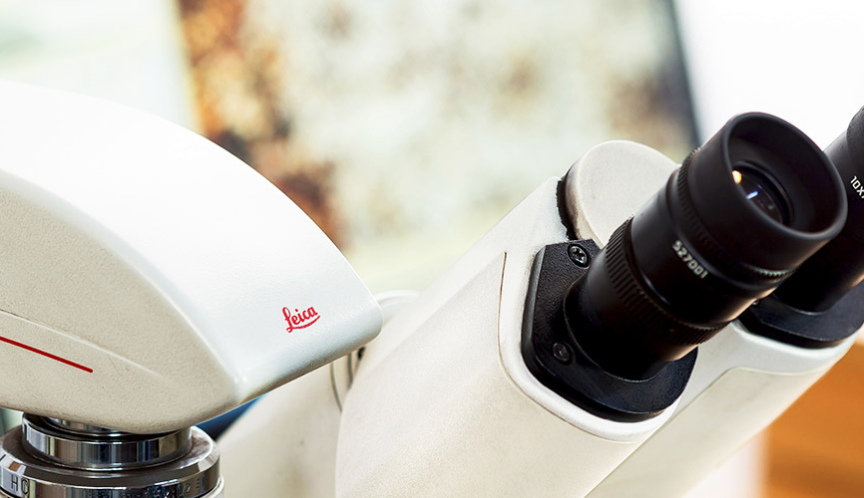
Production Processes
Quality
• Emission Spectrometer
OBLF Germany
• Tensile Strenght Testing Machine
Alşa
• Microscope
Leica
• Hardness Tester Rockwell
Bulut Makina
• Impact Test Machine
Alşa
• Sand Testing Equipment
George Fisher
• Crack Inspection

Slide 12
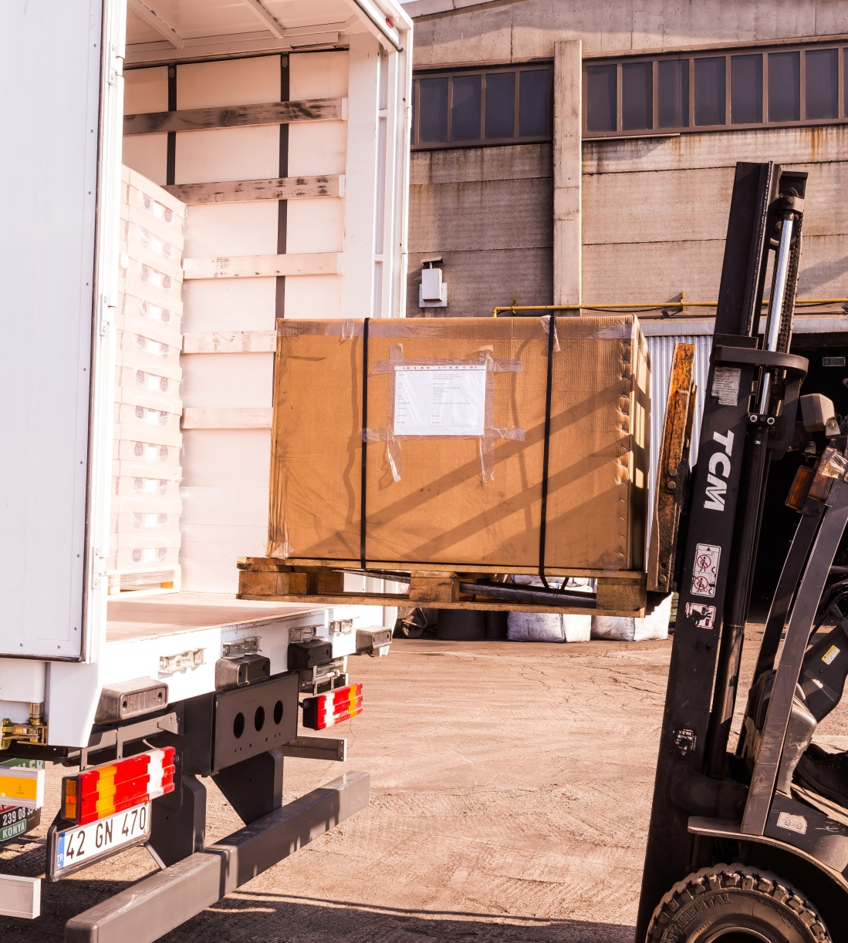
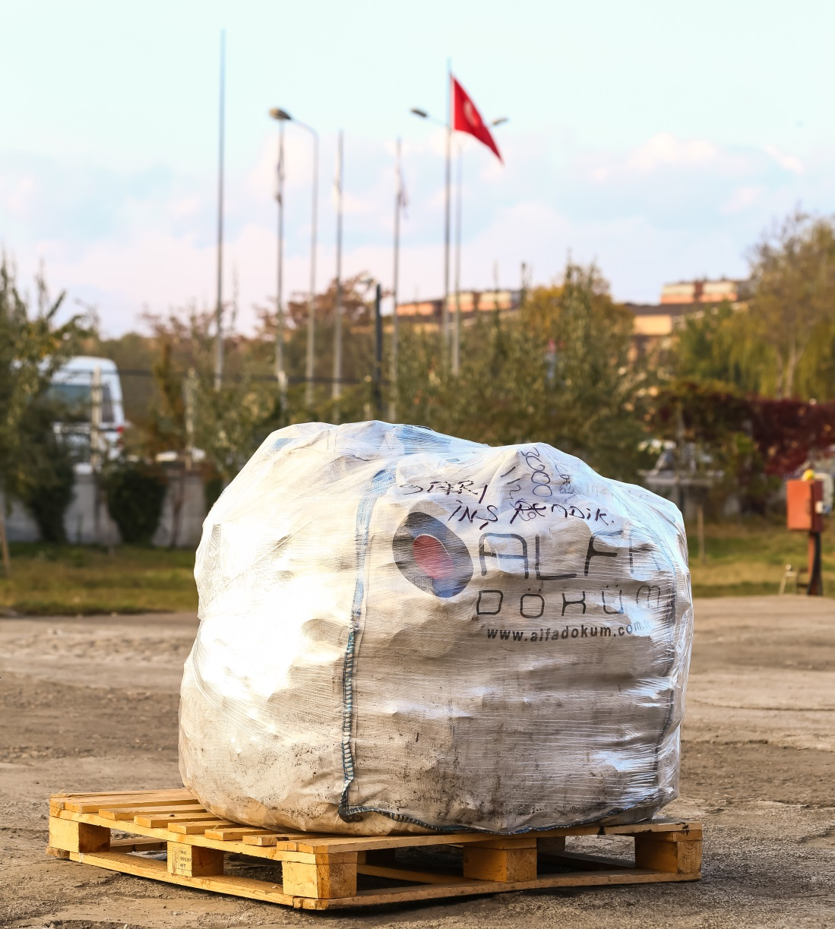
Production Processes
Packing & Delivery

Slide 13
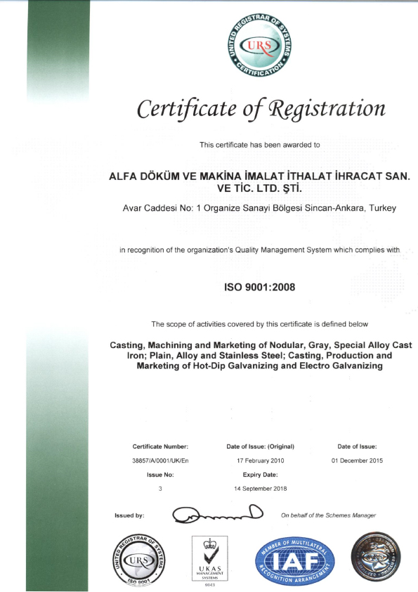
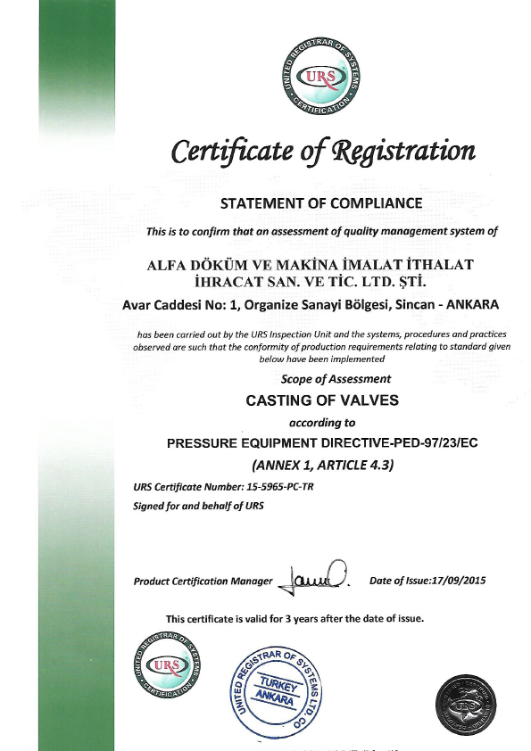
Quality Certifications
ISO 9001:2008
PED 9723

Slide 14
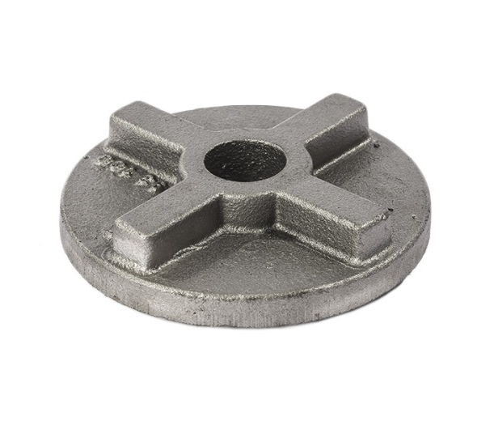
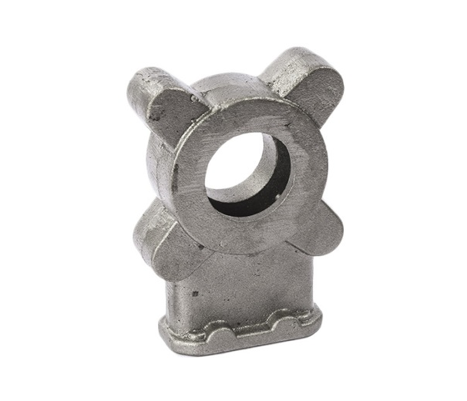
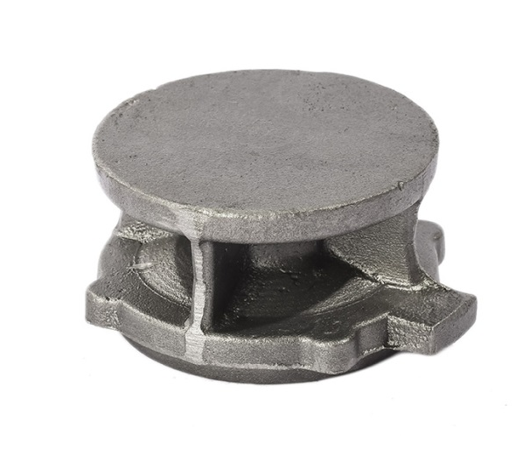
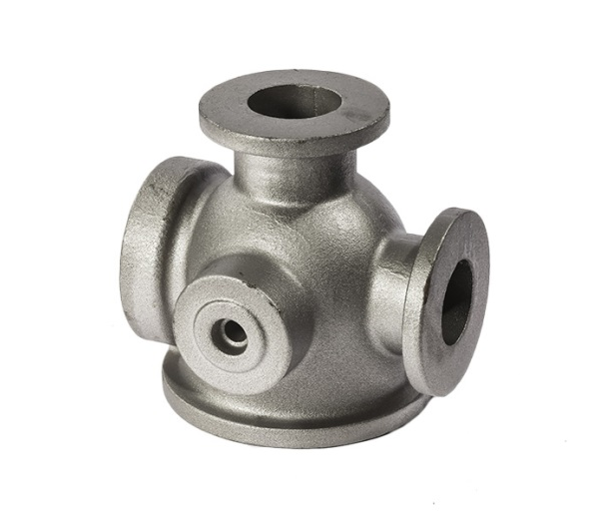
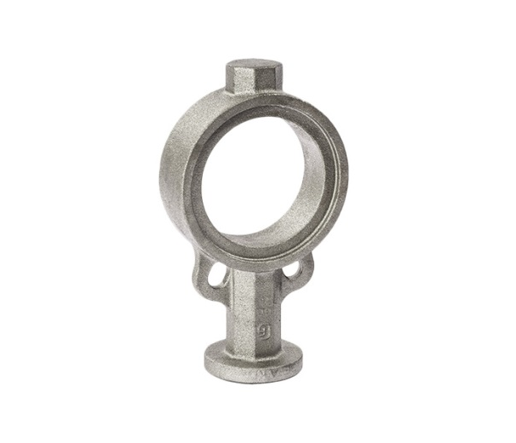
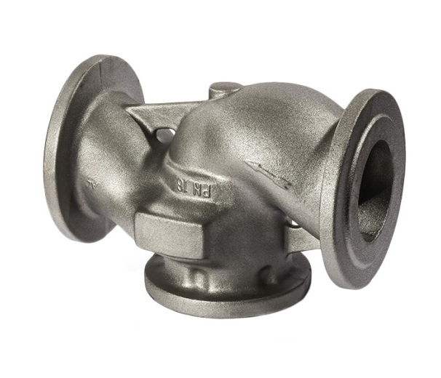
Our Products
Pump & Valve Industry

Slide 15
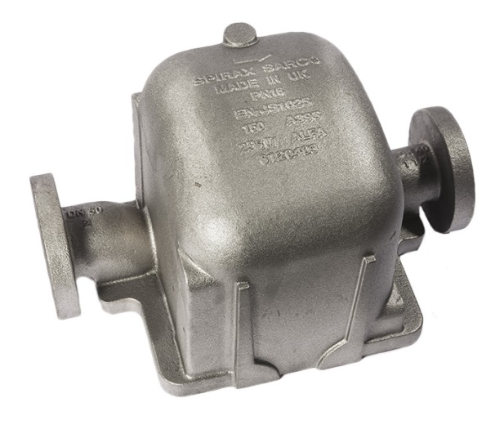
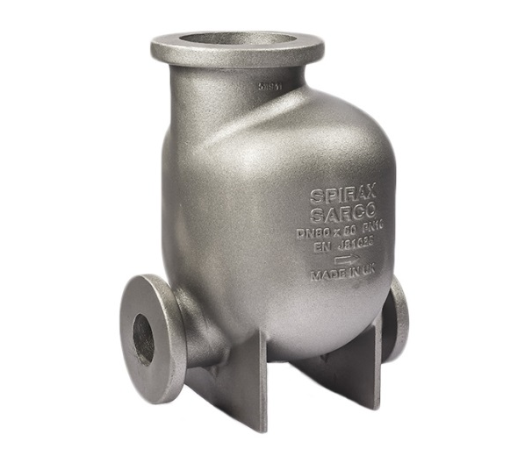
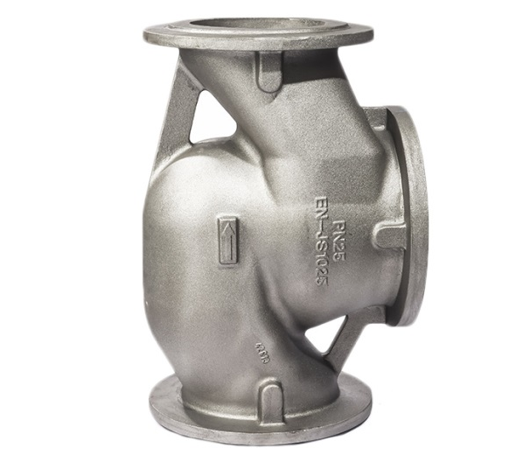
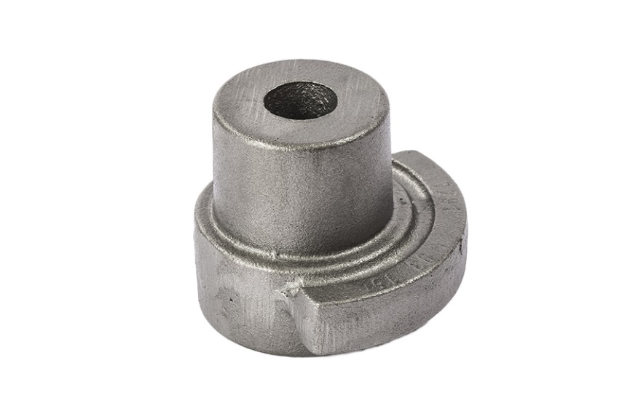
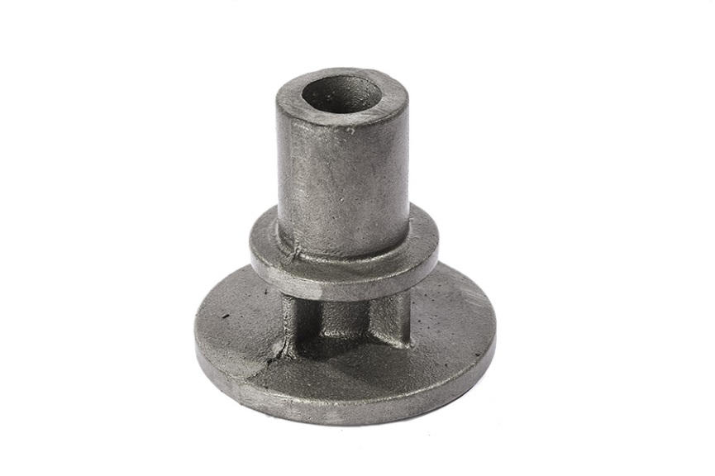
Our Products
Pump & Valve Industry

Slide 16
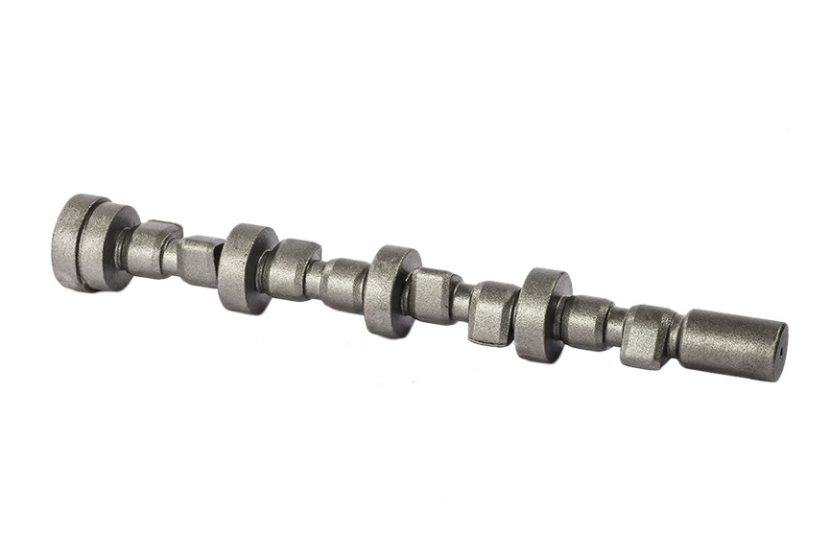
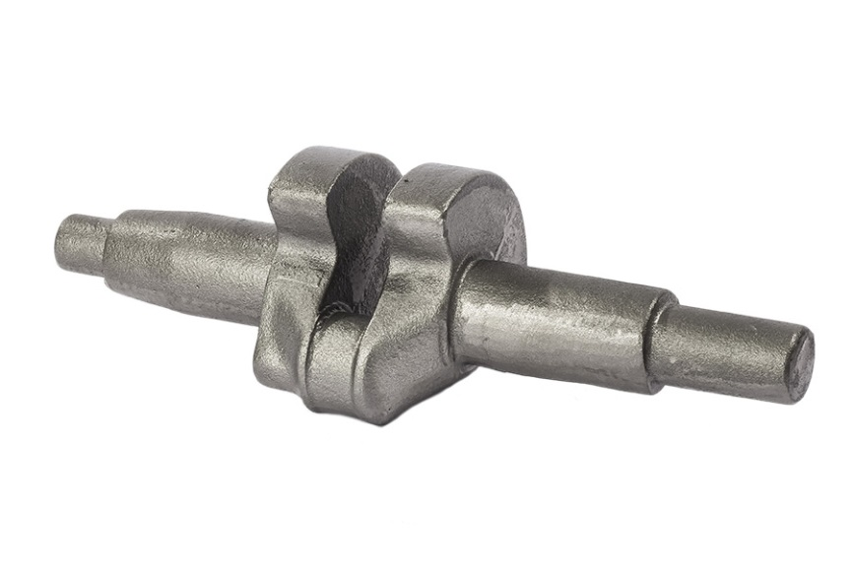
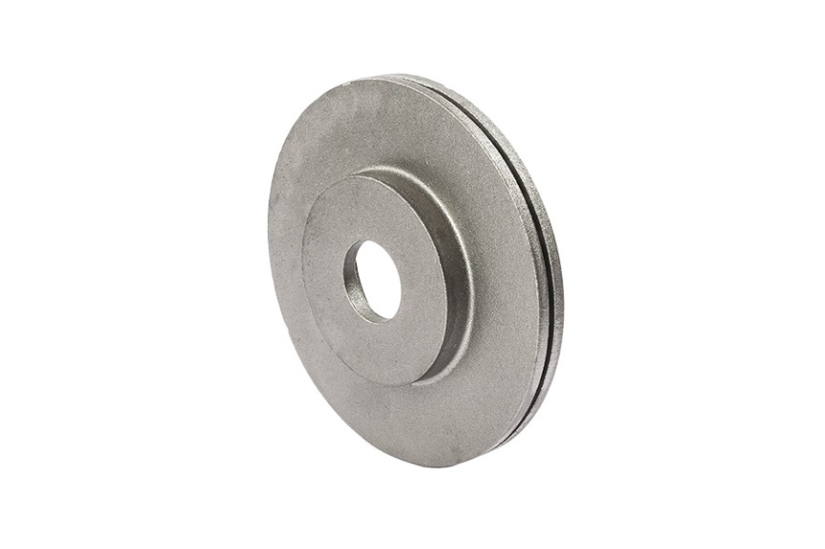
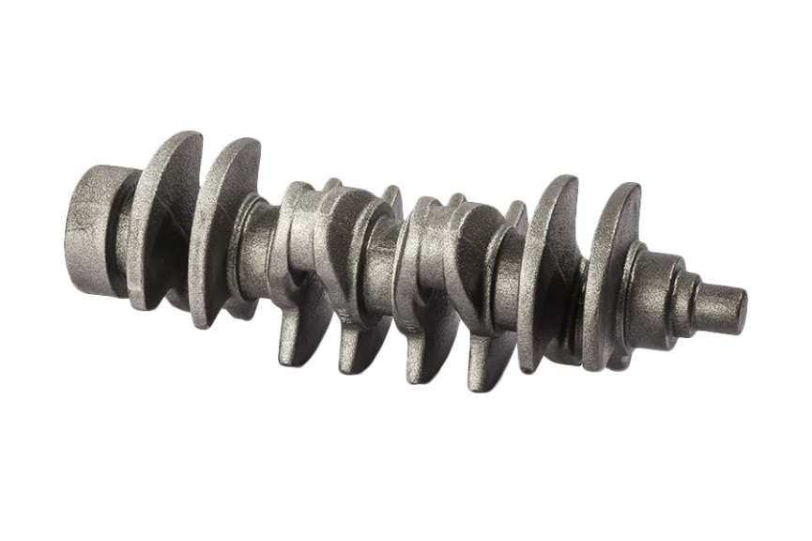
Our Products
Automotive

Slide 17
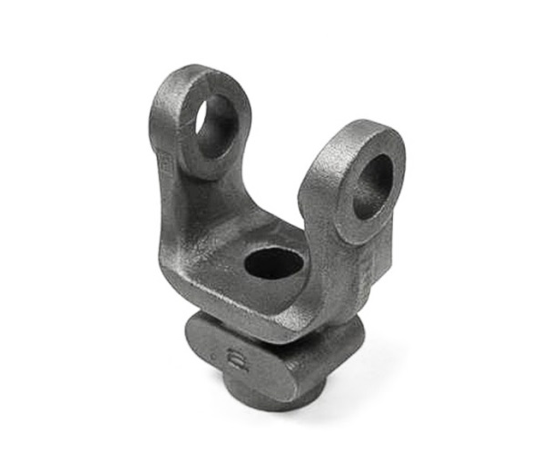
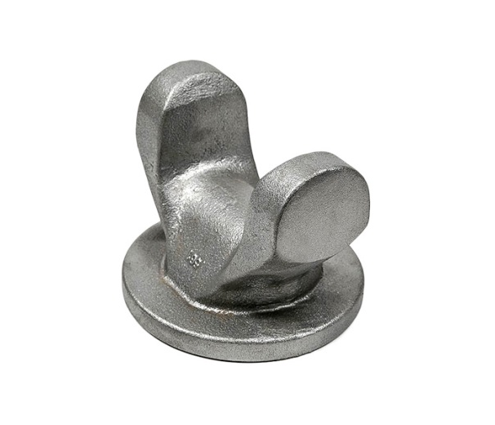
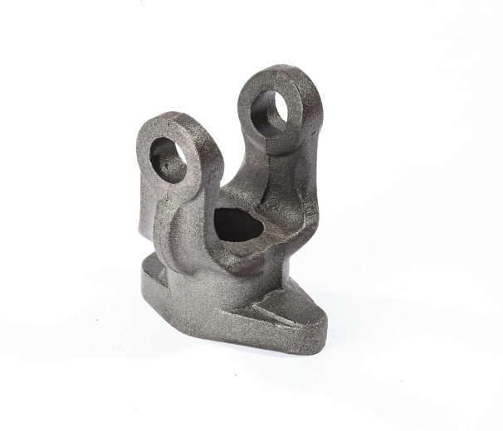
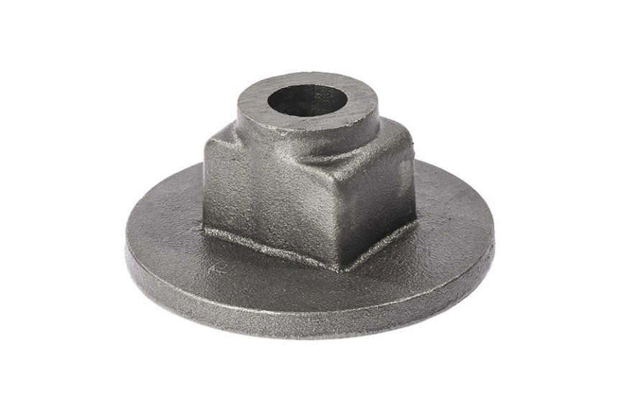
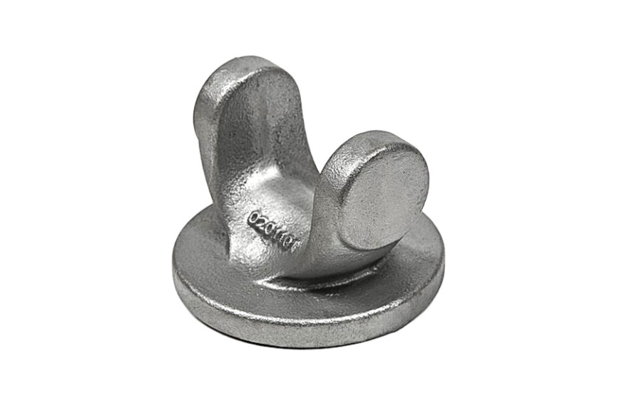
Our Products
Shaft

Slide 18
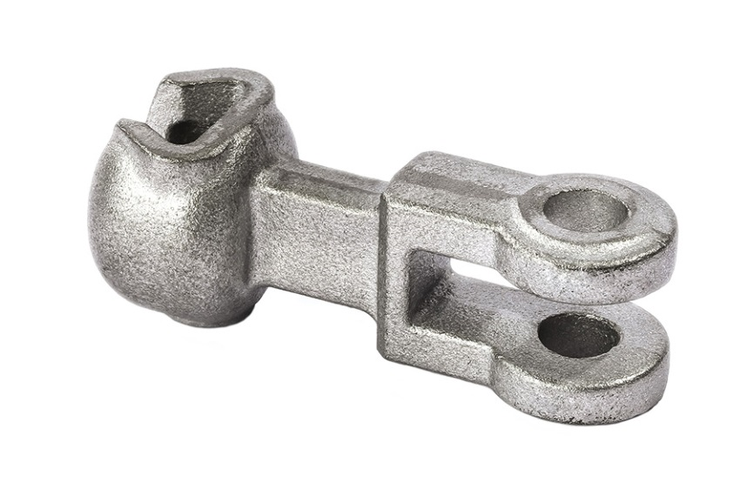
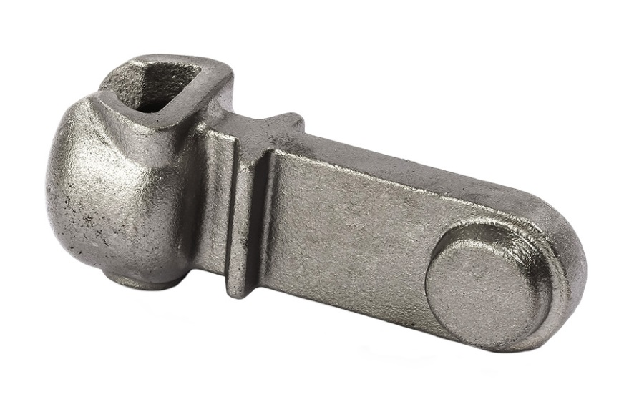
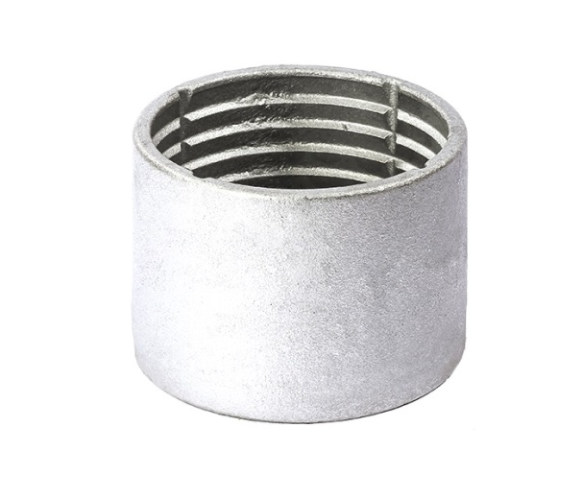
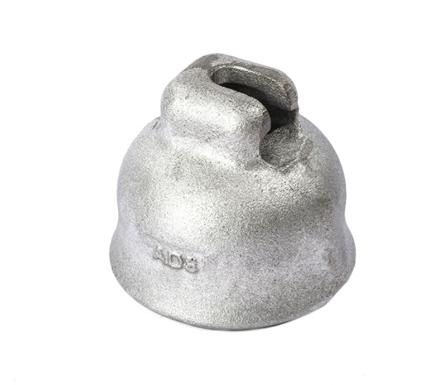
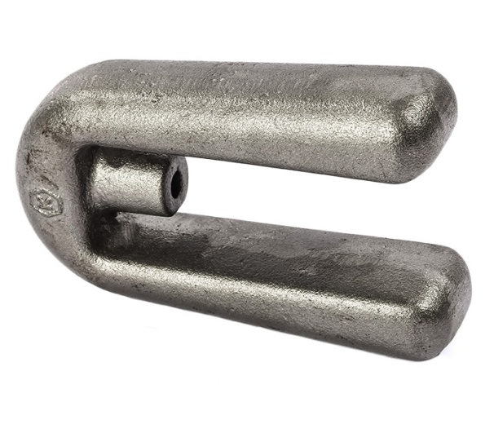
Our Products
Electricity

Slide 19
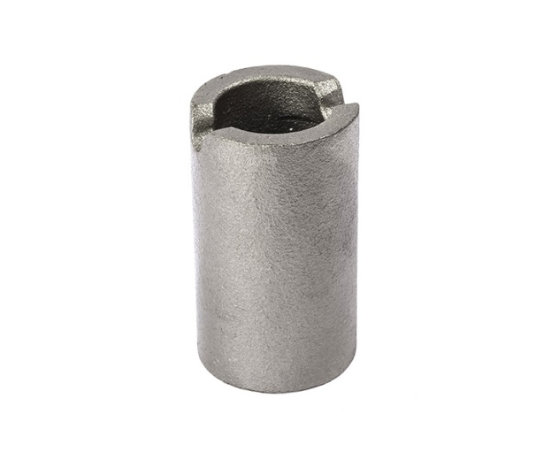
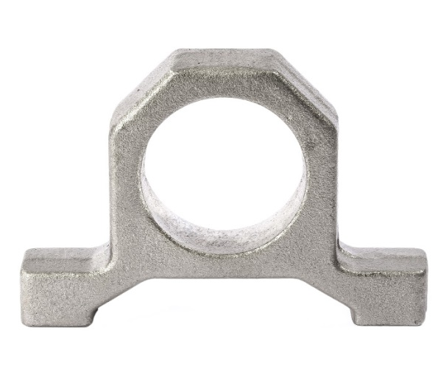
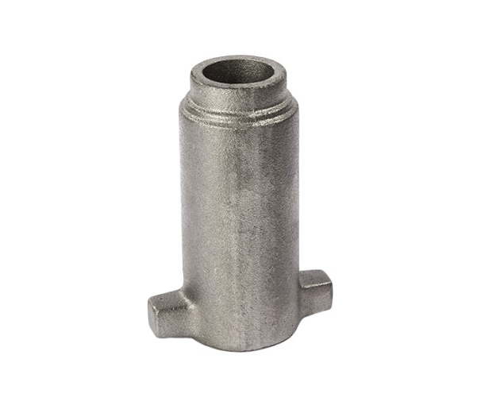



Our Products
Tractor

Slide 20





Our Products
Construction Machine Parts

Slide 21





Our Products
Machine Parts

Slide 22




Our Products
Machine Parts

Slide 23









Our Products
Scaffolding and Formwork Accessorize

Slide 24


Location & Contact Information
1.Organize Sanayi Bölgesi Avar Cad. No:1
Sincan / Ankara TURKEY
Tel: +90 312 267 17 97
Fax:+90 312 267 05 63
Web: info@alfadokum.com.tr
E-mail: www.alfadokum.com.tr

